Slide 1
Achieving Better Care by Monitoring All Prescriptions (ABC-MAP)
Act 191 of 2014
Pennsylvania's Prescription Drug Monitoring Program (PDMP)
May 17, 2016

Slide 2
ABC-MAP Presentation
Agenda
PDMP background and purpose
Pennsylvania's PDMP old vs. new
Definitions and requirements
Questions

Slide 3
Prescription Drug Monitoring Program
Background
A statewide electronic database monitoring tool that will gather information about the prescribing and dispensing of controlled substances
Notes:
The new DOH-managed PDMP system will track controlled substances in DEA Schedules II-V. The new system will replace the current OAG-managed (Office of Attorney General) PDMP database that collects only DEA Schedule II controlled substances.

Slide 4
Prescription Drug Monitoring Program
Purpose
Improve the quality of patient care by providing prescribers and dispensers access to information about all controlled substances dispensed to a patient
Encourage prescribers to refer addicted patients to a treatment center for evaluation
Aid regulatory and law enforcement agencies in the detection and prevention of fraud, drug abuse, and criminal diversion of controlled drugs
Notes:
Medical professionals will have access to a patient’s controlled substance prescription records to assist in making data-driven treatment decisions.
Patients will have access to their own prescription records, via the DOH PDMP Program Office, to aid them in making important health care decisions.
Law enforcement and regulatory bodies will access the system, via a request to the OAG, to be able to detect and prevent fraud, diversion and abuse.

Slide 5
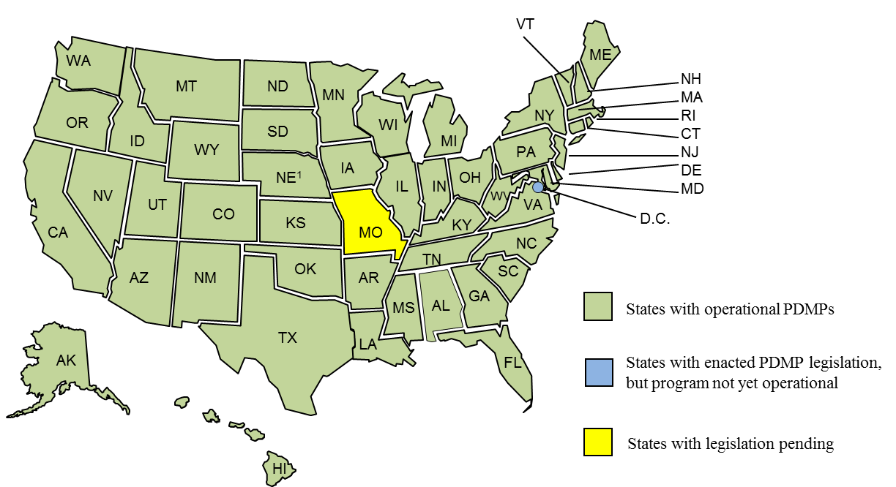
Prescription Drug Monitoring Program
STATUS OF PRESCRIPTION MONITORING PROGRAMS
California is credited with operation of the first monitoring program in 1939. Seventy-six years later, 49 states and D.C. have passed statutes establishing a PDMP. As of December 2014, 49 programs are collecting prescription data and providing authorized users access to that information. The District of Columbia is in the process of adopting regulations, and Missouri has several bills pending in the state legislature that would enact a PDMP.
Notes:
Act 191 (Section 9) gives access to prescribers; dispensers; OAG; approved DOH staff; designated Commonwealth personnel of licensing boards and medical assistance-type programs; DDAP personnel; medical examiners/coroners; prescription drug monitoring officials, dispensers, or prescribers of another state pursuant to an interoperability agreement; and patients.
In addition, according to the National Alliance for Model State Drug Laws, different statutes, for example, permit systems to provide unsolicited reports to various entities. States like Texas allow for unsolicited reporting to prescribers, pharmacists, law enforcement and licensing entities. Other states allow unsolicited reporting to other combinations of entities. Currently, PA sends unsolicited reports to law enforcement. Under Act 191, unsolicited reports will be sent to licensing boards only.

Slide 6
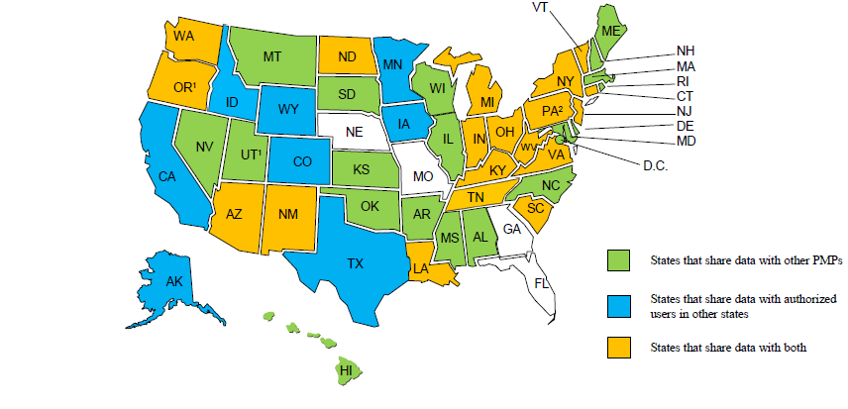
Prescription Drug Monitoring Program
INTERSTATE SHARING OF PRESCRIPTION MONITORING PROGRAM DATA
¹ Oregon will allow direct access to the PDMP to practitioners in CA, ID and WA.
² Pennsylvania provision went into effect June 30, 2015.
Notes:
Again, according to the National Alliance for Model State Drug Laws, 45 states allow interstate sharing of prescription drug monitoring program information. PA became the 46th state on June 30th 2015, and under Act 191, will also allow access to the system by prescription drug monitoring officials in other states that have an “interoperability agreement” with us.

Slide 7
Prescription Drug Monitoring Program
Current
New
Pennsylvania has a prescription monitoring system in the Office of Attorney General.
It collects only Schedule II drug information.
Pharmacies are only required to report their dispensations monthly.
Prescribers and medical professional do not have access to the current monitoring system.
Pennsylvania is transitioning from the current prescription monitoring system managed by the Office of Attorney General to the Department of Health in the Prescription Drug Monitoring Program office.
It collects Schedule II-V controlled substances data.
Dispensers are required to submit prescription data within 72 hours of dispensing the controlled substance.
Prescribers and medical professionals can have access to the database. They can assign delegates.
Notes:
The current law is designed exclusively for law enforcement and focuses only on the most addicting and dangerous controlled substances.
The new law increases the types of authorized Users and expands the monitored categories to all controlled substances available by prescription.
While retaining the law enforcing aspects of the current law, the new law seeks to place equal emphasis on helping prescribers, dispensers, and patients to avoid accidental addiction or overdose situations. This includes educating medical professionals, patients, and the public on the dangers as well as the benefits of these very powerful drugs. It also includes helping patients who are either already addicted or at risk of becoming addicted, to get appropriate treatment for their disorder.

Slide 8
Requirements: Dispensers
Requirements:
Dispensers and pharmacies:
Must electronically submit information to the system for each controlled substance dispensed
Name of prescriber
Prescriber’s DEA number
Date prescription written
Date prescription dispensed
Name, DOB, gender and address of person receiving the prescription
National Drug Code
Quantity and days’ supply
DEA registration number and National Provider Identifier of dispenser
Method of payment for the prescription
Notes:
Note – Under certain conditions, dispenses may be allowed to submit via paper forms.

Slide 9
Requirements: Prescribers
Prescribers:
Must query the system:
For each patient the first time a patient is prescribed a controlled substance by the prescriber
If a prescriber believes the patient may be abusing or diverting
Must indicate the information obtained from the system in the patient’s record if the patient is a new patient or if it is determined that the drug should not be prescribed based upon information from the system
Notes:
Initial query is to establish a patient’s baseline and a thorough medical record.
However, the prescriber/dispenser will not be in violation of the Act if, in his or her sound clinical judgment, the prescriber/dispenser does not believe that a patient is abusing or diverting controlled substances, and the prescriber/dispenser is otherwise in compliance with the Act.
3) Finally, a prescriber/dispenser who has submitted or obtained information from the system and held under the confidentiality requirements of the Act is immune from civil liability or discipline in a licensing board action

Slide 10
Pennsylvania’s PDMP Team Structure
Lauren S. Hughes, MD, MPH, MSc, FAAFP
Deputy Secretary for Health Innovation
Pennsylvania Department of Health
Jared Shinabery, MPH
Chief Technology Officer, PDMP Office
Epidemiologist
TBD
Meghna Patel, MHA
Director, Prescription Drug Monitoring Program (PDMP) Office
Pennsylvania Department of Health
Norman Spotts
Statistical Analyst,
PDMP Office
Public Health Program Assistant Administrator
TBD

Slide 11
Definitions
Definitions:
Controlled Substance: drug, substance or immediate precursor under the Controlled Substance, Drug, Device and Cosmetic Act or the Controlled Substances Act of 1972, P.L. 233, No. 64
Notes:
Includes both state and federally-designated controlled substances.

Slide 12
Definitions
Dispenser: someone authorized to deliver a controlled substance to a patient by lawful order of a prescriber
Exceptions:
Licensed health care facility for use in that facility
Correctional facility
Authorized person who administers a drug
Wholesale distributor
Licensed provider in the LIFE (Living Independence for the Elderly) program
Provider of hospice
Prescriber at a licensed health care facility if the quantity is for no more than five days
Veterinarian
Notes:
LIFE is a program of medical and supportive services known as Living Independently for Elders, within the state DHS (adult day care).

Slide 13
Definitions
Prescriber: Person licensed, registered or otherwise authorized to distribute, dispense or administer a controlled substance

Slide 14
ABC-MAP Board
Members:
Secretary of Health as the chair
Secretaries of Human Services, Drug and Alcohol Programs, State and Aging
Commissioners of Insurance, Pennsylvania State Police
Attorney General
Physician General, if Secretary of Health is not a physician
Notes:
They will serve for the duration of their appointment. The Act allows for any Board member to select a designee to serve on the Board in his or her stead.

Slide 15
Questions
How is the PDMP supposed to work in my practice?
How will the state be using the PDMP?
What are the expectations of individual physicians?
What do I do if a “red flag” pops up about a patient?
How well will the PDMP be integrated into my EHR?

Slide 16
Questions
QUESTIONS?

